Slide 1

Lecture 1: Introduction to Prompt Engineering
Changwen Xu

Slide 2
Have you ever wondered about the process through which AI models, such as GPT-3, generate text that resembles human language?
How does it impact chatbots, content generation, and even recommendation systems?
What is prompt engineering, why it holds significance, and how it impacts the output of language models?
Notes:
Let's start by understanding what prompt engineering is. In its essence, prompt engineering is the art of strategically crafting input queries or prompts to language models to elicit specific and desired outputs. It's the key that unlocks the potential of language models, shaping how they interpret and respond to our queries.

Slide 3
Lecture Overview:
Definition of Prompt Engineering
Impact of Prompts
Prompt Engineering in Context
Practical Example
Real-World Applications

Slide 4
What is Prompt Engineering?
Definition of prompt engineering.
Importance and relevance.
Examples of prompt engineering in real-world applications.
The role of prompts in controlling language models.

Slide 5
Definition of prompt engineering：
Prompt engineering involves structuring text in a way that a generative AI model can interpret and understand. A prompt is a piece of natural language text that describes the task an AI is expected to perform.
Prompt engineering entails crafting prompts that are not only clear and effective but also contextually relevant, aiming to achieve the desired results from AI models.
Notes:
Prompt engineering refers to the deliberate and strategic design of prompts or inputs given to a machine learning model, particularly natural language processing models like chatbots or language generators. The goal of prompt engineering is to shape the behavior of the model and guide it towards producing desired outputs.
In the context of language models, such as GPT (Generative Pre-trained Transformer) models, prompt engineering involves carefully crafting prompts to elicit specific responses. It's a process of experimenting with the language and structure of prompts to achieve optimal results. This may include adjusting the phrasing, providing additional context, or employing various techniques to encourage the model to generate more accurate, coherent, or contextually appropriate responses.
Effective prompt engineering is crucial when working with pre-trained models, as it allows users to harness the model's capabilities while mitigating potential shortcomings or biases. It involves an iterative process of refining prompts based on the model's behavior and the desired outcomes. This approach helps users obtain more useful and relevant information from the model, making the interaction more productive and aligned with their goals.

Slide 6
Why is Prompt Engineering Essential for us?
Crafting effective prompts empowers individuals to make more precise data-driven decisions.
Through prompt engineering, businesses gain the ability to harness AI tools and systems effectively, ensuring their competitiveness in an ever-evolving digital environment.
Notes:
Prompt engineering is all about teaching AI to understand us really well. Moreover, it’s like writing a clear set of instructions so AI knows exactly what we want. In addition, this is super important because AI can give us spot-on answers when it gets it. And in the business world, this is a big deal. It means AI can make really smart decisions and help companies succeed in what they do.
It’s like explaining a game to a friend, ensuring every rule is crystal clear. This is incredibly important because when AI understands exactly what we mean, it can give us accurate answers. In turn, this has a big impact on businesses because it means AI can help them make wise decisions and achieve impressive results. Just as a well-trained chef follows a recipe to make a delicious dish, prompt engineering guides AI to deliver success in the business world.

Slide 7
Examples of the Importance of Prompt Engineering.
Enhanced accuracy and relevance
Improved decision making
Efficient resource utilization
Ethical considerations and bias mitigation
Adaptability to industry-specific requirements
Notes:
1. Enhanced accuracy and relevance
By leveraging prompt engineering, organizations can ensure that AI models generate outputs that are highly accurate and relevant to their specific objectives. The careful crafting of prompts allows AI systems to understand contextual nuances, interpret data effectively, and provide precise insights, minimizing errors and optimizing outcomes.
2. Improved decision making
The prompt engineer enables organizations to extract actionable intelligence swiftly from vast amounts of data. By fine-tuning prompts, businesses can obtain relevant information, make informed decisions, and respond promptly to market dynamics. This ability to harness AI-driven insights empowers organizations to gain a competitive edge and drive strategic business growth.
3. Efficient resource utilization
Efficiency is the key to optimizing resources and reducing costs. Prompt engineering plays a vital role in achieving efficient AI systems by reducing unnecessary computations and optimizing resource utilization. Through fine-tuning prompts, organizations can streamline AI processes, saving computational resources and ultimately optimizing costs.
4. Ethical considerations and bias mitigation
Ensuring ethical AI practices is essential for organizations. Prompt engineering allows businesses to address biases and promote fairness within AI systems. By incorporating ethical considerations into prompt design, organizations can develop responsible AI solutions that mitigate potential biases, promote inclusivity, and avoid harmful consequences.
5. Adaptability to industry-specific requirements
Different industries have unique requirements and contexts. Prompt engineering enables organizations to fine-tune AI models to capture industry-specific nuances, ensuring that the generated outputs align with the needs of the organization. This adaptability helps organizations optimize AI systems to suit their industry dynamics and maximize the value derived from AI implementations.

Slide 8

Examples of prompt engineering in real-world applications:
Chatbots and Virtual Assistants
Content Generation
Data Analysis
Language Translation
Recommendation Systems
Coding and Programming
Storytelling and Entertainment
Notes:
Prompt engineers can then use that data in their prompts to create conversational content. For example, if a chatbot provides customer support, prompt engineers can update it with the latest information about products and services. This helps ensure customers get the help they need.

Slide 9
The Role of Prompts in Controlling Language Models：
Through the provision of explicit instructions or conditioning, AI language models can be guided to generate responses with specific characteristics or styles.
Well-crafted prompts have the potential to reduce bias in AI-generated content.
Notes:
System prompts serve as initial instructions that shape the behavior of the language model. In contrast, user prompts enable users to interact with the model and receive specific responses. Crafting well-defined and precise prompts is essential for obtaining accurate and desirable outputs from the model.

Slide 10
Impact of Prompts:
Explain how prompts affect model outputs.
Illustrate the difference between good and bad prompts.
Discuss the power and limitations of prompts.

Slide 11
Explain How Prompts Affect Model Outputs:
Clear and specific prompts enable AI models to have a better understanding of the tasks they are asked to perform.
As a result, this leads to responses that are not only more accurate but also more relevant, unique, and consistent.
Notes:
Prompts significantly influence the outputs of language models. The way a prompt is constructed, the information it includes, and the instructions it provides all play a crucial role in shaping the model's responses.
Prompts act as a vital interface between users and language models. They provide the necessary instructions, context, and constraints to guide the model's behavior, ultimately influencing the nature and quality of the generated outputs. As users refine and optimize their prompts, they gain greater control over the language model's responses, tailoring them to specific needs and achieving more accurate and meaningful interactions.

Slide 12
Illustrate the Difference Between Good and Bad Prompts:
Good “Prompts”:
Use simple, straightforward language.
Start with basic concepts (e.G., Recall) to build toward more advanced thinking (E.G., Evaluation).
Foster long-term content retention.
Encourage continual questioning and exploration.
Ensure accessibility for students, considering cultural references, language, and background knowledge.
Align with specific learning goals and intended psychological outcomes.
Bad “Prompts”:
Avoid vague or ambiguous language.
Ensure content is relevant to the intended goals and objectives.
Keep explanations simple and straightforward.
Avoid content that discourages critical thinking.
Ensure content is based on sound premises.
Steer clear of bias and logical fallacies.
Prioritize reason and knowledge over personal opinions and beliefs.
Notes:
Good prompts are specific, clear, and provide sufficient context or instructions for the language model. They guide the model toward generating relevant and accurate responses. On the other hand, bad prompts are vague, overly general, or ambiguous, making it difficult for the model to understand the user's intent and resulting in less useful outputs.

Slide 13
Discuss the power and limitations of prompts:
While prompts offer a powerful means of influencing generative AI responses, it's essential to recognize that the model's output is still generated through learned patterns and examples.
Hence, reviewing and validating the generated text is essential to guarantee accuracy and reliability.
Notes:
Prompt engineering, which involves crafting specific prompts to elicit desired responses from language models like GPT-3, has its own set of limitations, including:
Length Constraints: Many language models have limitations on the length of the input prompt they can accept. For example, GPT-3 has a maximum token limit (e.g., 4096 tokens for the largest model). This means that complex or lengthy prompts may need to be truncated or shortened, potentially losing context and affecting the quality of responses.
Complexity of Task: If a task or question is highly complex, it may be challenging to craft a concise and effective prompt that accurately conveys the desired context and information. The model may struggle to provide meaningful responses to such prompts.
Ambiguity: Language is inherently ambiguous, and prompts may inadvertently introduce ambiguity or vagueness, leading to responses that are not as specific or accurate as desired. Ambiguous prompts can result in unpredictable model behavior.
Bias and Fairness: Crafting prompts that avoid bias and promote fairness can be difficult. Biased language or framing in prompts can lead to biased responses from the model. Achieving fairness in prompt engineering requires careful consideration of language and context.
Overfitting: Overfitting occurs when prompts are too tailored to a specific dataset or context, causing the model to perform poorly on general tasks or in different scenarios. Prompts should strike a balance between specificity and generalizability.
Lack of Creativity: Overly prescriptive prompts can limit the model's ability to generate creative or novel responses. If prompts are too rigid, the model may produce repetitive or uninteresting output.
Semantic Understanding: Language models like GPT-3 may not have a deep understanding of the world or context, and they rely heavily on the input provided. Crafting prompts that effectively communicate context or nuances can be challenging, especially for complex or domain-specific tasks.
Evaluation Challenges: Evaluating the quality of prompts and the resulting responses can be subjective and time-consuming. There may not always be clear criteria for assessing the effectiveness of a prompt.
Ethical Considerations: Crafting prompts that align with ethical guidelines and avoid harmful or biased content is a crucial concern. Ensuring responsible prompt engineering requires careful thought and consideration.
Resource Intensity: Developing effective prompts can be resource-intensive, especially for complex tasks. It may require domain expertise and iterative experimentation to find the right prompts that yield desired results.
Despite these limitations, prompt engineering remains a powerful tool for leveraging language models. Effective prompt design, combined with ongoing research and ethical considerations, can help mitigate some of these challenges and harness the capabilities of language models for various applications.

Slide 14
Prompt Engineering in Context:
Place prompt engineering in the broader context of natural language processing.
Prompt engineering is the formal search for prompts that retrieve desired outputs from language models, where what is desirable is determined by the end user.
Notes:
In-context learning (ICL) is a specific method of prompt engineering where demonstrations of the task are provided to the model as part of the prompt (in natural language). With ICL, you can use off-the-shelf large language models (LLMs) to solve novel tasks without the need for fine-tuning.

Slide 15
Prompt Engineering in our Daily Life

Slide 16
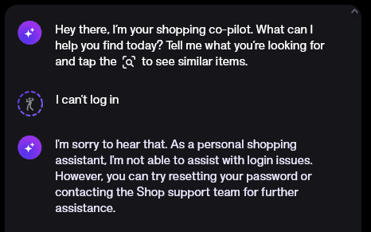
Example 1: Customer Support Chatbot
Consider a company aiming to deploy a chatbot for addressing frequently asked customer queries.
Notes:
Creating a customer support chatbot involves a strategic approach to design, functionality, and communication style, all aimed at delivering a positive user experience. A critical aspect is understanding user intent, achieved through the implementation of natural language processing (NLP) to accurately interpret user queries. Crafting effective prompts is essential to guide users in providing clear and specific information about their issues. This ensures that the chatbot can effectively comprehend and address the problem at hand.
Information gathering is streamlined through well-designed questions that prompt users to share relevant details such as order numbers, account information, or specific error messages. The ability to support multi-turn conversations is crucial for addressing complex queries, requiring the chatbot to remember context from previous interactions and maintain coherent dialogues. Integration with backend systems, such as databases or CRM systems, allows the chatbot to access and update customer information, contributing to a more efficient support process.
Security measures are paramount, with the implementation of secure processes to safeguard access to customer data. Clear communication of the chatbot's capabilities and limitations helps manage user expectations, and a seamless handoff to human agents is facilitated by systems that escalate complex issues appropriately. Personalization adds a layer of sophistication to interactions, utilizing customer data to tailor responses and enhance the overall user experience.
Continuous learning and improvement are supported by mechanisms for feedback collection, allowing the chatbot to evolve over time based on user interactions and changing customer needs. A user-friendly interface, designed for easy navigation and potentially incorporating visual elements like buttons or quick-reply options, contributes to a more intuitive experience. Monitoring chatbot performance and leveraging analytics tools enable data-driven improvements, ensuring the chatbot remains effective in assisting users and maintaining high levels of customer satisfaction. By carefully addressing these aspects, organizations can develop a customer support chatbot that seamlessly integrates into their support infrastructure and significantly enhances the overall customer experience.

Slide 17

Example 2: Content generation：
Effective prompt engineering entails specifying the desired type of AI output and the preferred presentation style.
Effective prompt engineering entails specifying the desired type of AI output and the preferred presentation style.
Notes:
Prompt Engineering offers tools to guide AI in generating such content. Whether you're crafting prompts for blog posts, marketing campaigns, or academic articles, incorporating directives for gender-neutral pronouns and avoiding gendered language can make a world of difference in how your content is received.

Slide 18
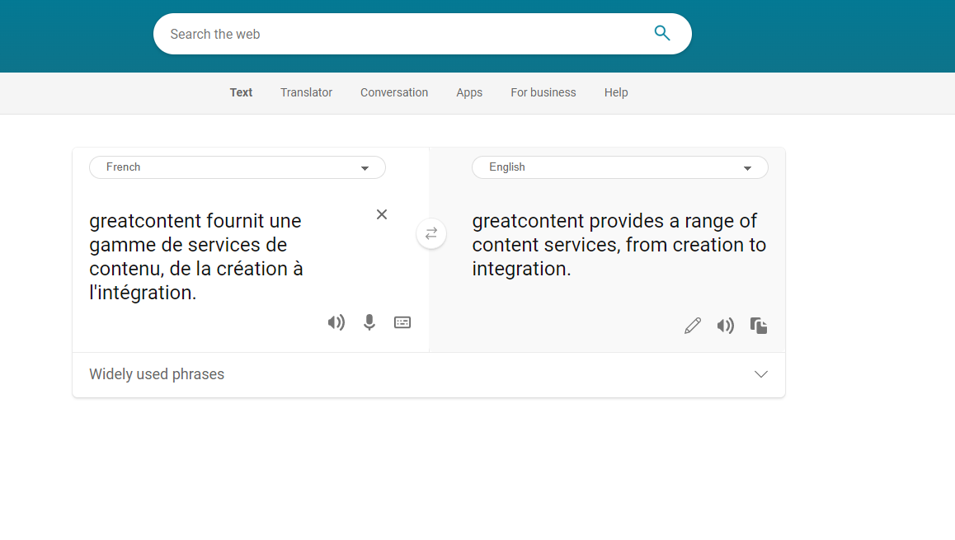
Practical Example 3: Multilingual Language Translation
Utilizing prompt engineering enables translation services to produce highly accurate, brand-specific content without relying on human linguists.
Notes:
The provided content outlines a set of strategies and considerations for effective prompt engineering in the realm of multilingual language translation. In this context, the primary goal is to design prompts that adeptly guide language models in generating accurate and contextually appropriate translations. These strategies address various aspects of the translation process, ensuring a nuanced and precise output that aligns with user expectations.
A fundamental strategy highlighted in the content is the explicit specification of both the source and target languages in prompts. This clear guidance sets the foundation for accurate translations. Bilingual prompts, another emphasized approach, involve incorporating both the source and target languages within the prompt itself, contributing to improved alignment and clarity.
The content delves into considerations for handling ambiguous words, technical vocabulary, and the formality of language. Providing context for ambiguous terms and incorporating technical jargon into prompts helps ensure accurate translations, especially in specialized domains. Addressing the formality or informality of the tone is crucial, as it can significantly impact the choice of words in the translated output.
Cultural considerations also play a key role in translation. The content suggests incorporating instructions that account for cultural nuances, gender, pluralization. These considerations ensure that the translated content not only captures linguistic accuracy but also reflects cultural sensitivity and appropriateness.
Furthermore, the content encourages experimentation with different phrasings to find the most effective way to convey the translation task. It highlights the importance of providing feedback for improvement, fostering an iterative process where the model can learn and refine its translations based on user guidance.
In summary, the outlined strategies offer a comprehensive guide for prompt engineering in multilingual translation, covering linguistic, cultural, and user-specific considerations. By incorporating these strategies, practitioners can guide language models to produce translations that go beyond mere linguistic accuracy, addressing the intricacies of language use, cultural nuances, and user preferences in a multilingual context. This approach ultimately enhances the overall quality and relevance of the translated content.

Slide 19

Example 4: Recommendation Systems
Prompt engineering is gaining significance in consumer recommendation systems.
You can supply AI models with a shopper's product preferences and generate recommendations based on both those preferences and the purchasing history of similar customers.
Notes:
The provided content delves into the realm of recommendation systems, specifically focusing on the crucial role of prompt engineering in designing queries that effectively guide language models to generate personalized and relevant recommendations. Whether applied to movie recommendation systems, product recommendation systems, or any other type of recommendation engine, the quality of prompts is identified as a factor in achieving optimal results.
The outlined strategies for prompt engineering in recommendation systems cover a broad spectrum of considerations. Beginning with capturing user preferences, the content suggests prompts that seek recommendations based on specific user favorites and preferences, incorporating factors like tone. Clear specification of criteria, such as genre, price range, or rating, ensures that recommendations align with user-defined parameters, enhancing the relevance of the suggestions.
Contextualization is emphasized throughout the strategies, whether it involves providing context to guide the model's understanding of user preferences, adapting to dynamic preferences, considering factors, or factoring in seasonal and temporal aspects for timely recommendations. The importance of incorporating user feedback for continuous improvement and adaptability is highlighted, reflecting an iterative approach to refining recommendations based on user interactions.
Moreover, the content explores the significance of exploring cross-domain recommendations, setting thresholds or constraints for recommendations, and ensuring explainability in the generated suggestions. The need for diversity in recommendations is acknowledged, encouraging experimentation with diverse genres, categories, or types of items to enhance the user experience.
In conclusion, the outlined strategies collectively contribute to the goal of enhancing recommendation systems by guiding language models to understand user preferences and generate more personalized, contextually relevant, and satisfying recommendations. The content underscores the role that prompt engineering plays in optimizing recommendation engines, offering a comprehensive guide for people seeking to improve the effectiveness of their systems through thoughtful and strategic prompt design.

Slide 20

Example 5: Design and Prototyping
Architects, product designers, and artists can utilize prompt engineering to fuel their creativity and bring their concepts to life. By providing AI models with design parameters like materials, dimensions, and aesthetics, professionals can swiftly generate 3D models.

Slide 21

Example 6: Code Generation & Data Analysis
Language models engineered with specific prompts can aid developers by producing code snippets, offering code completion suggestions, and assisting in debugging intricate software systems.
Notes:
In simple terms, the content explains how to guide computer programs to write code or analyze data by asking them specific questions. If you want a program to write a piece of code for you, you can ask it in a way that tells it which programming language to use, what task you want it to do, and how to handle different situations. For example, you might ask it to create a program in Python that calculates the factorial of a number.
On the other hand, if you want the program to analyze data, you can ask questions about what you want to find out, what data you have, and how you want the results presented. For instance, you could ask it to analyze a sales dataset and tell you trends in customer buying behavior.

Slide 22

CHAT GPT Time!

Slide 23
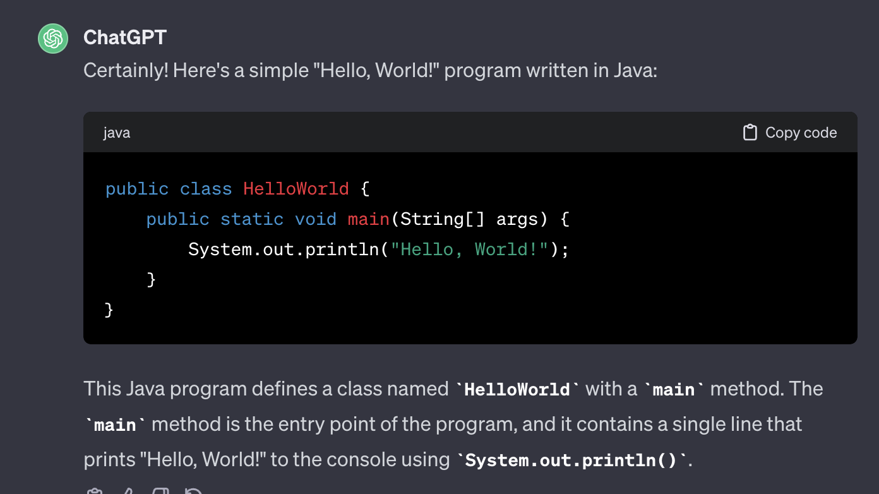
Notes:
Just provide it with the details of what you're trying to accomplish. Include any specific requirements, programming language preferences, and any other relevant information. If you have a particular problem or task in mind, let it know the details, and it will assist you in generating the code.

Slide 24

Notes:
If you want to ask gpt a question or seek information, simply start your message with your inquiry or topic of interest. You can phrase your question naturally, and it will to provide a helpful response based on the information. One thing need to be care is that gpt last training cut-off is in January 2022.

Slide 25
Conclusion:
The realm of AI has undergone a profound transformation, offering boundless possibilities and futuristic applications.
Prompts can direct AI models similarly to human instructions, ushering in a revolution in the future, as demonstrated by examples like ChatGPT. Understanding the underlying principles and fundamentals is essential for effective AI utilization.
Notes:
In conclusion, prompt engineering is more than a technique; it's a powerful tool that empowers us to shape the capabilities of language models. Our exploration has just begun, and in the upcoming lectures, we'll dive deeper into the nuances, applications, and evolving landscape of prompt engineering.
Thank you for joining me on this journey. I'm excited about what lies ahead, and I encourage you to engage, ask questions, and let your curiosity guide us through this exploration of prompt engineering.

Slide 26

Thanks for Listening!

